Slide 1


Slide 2

Sprint 3 Data Analytics + ML

Slide 3
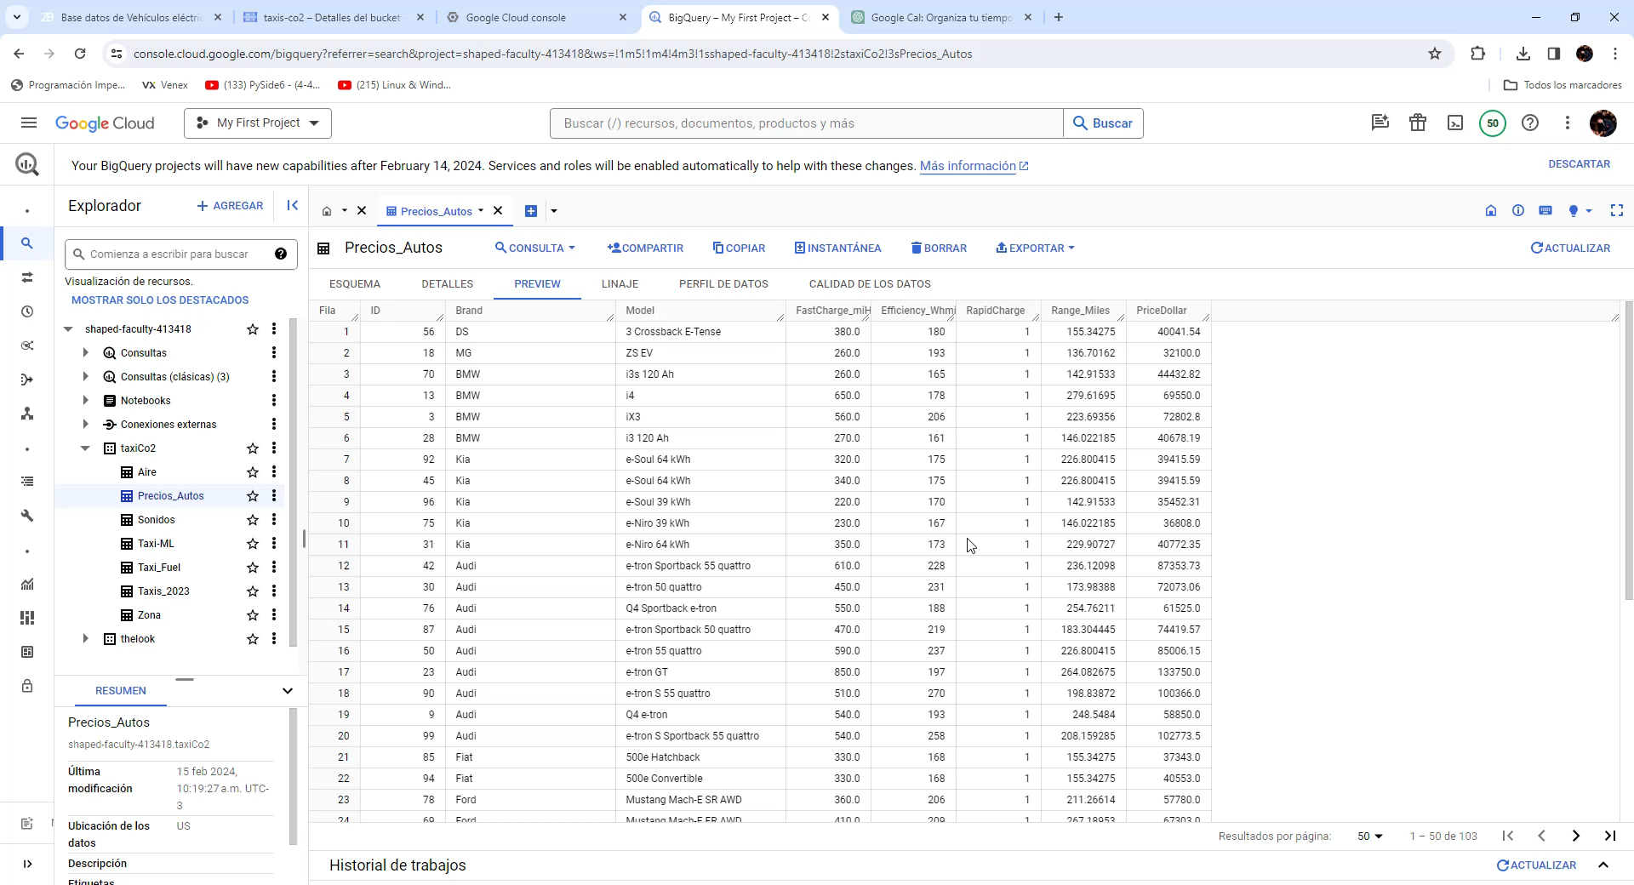
Pipeline ETL Automatizado

Slide 4

Modelos ML

Slide 5

DASHBOARDS

